Slide 1
Titanic – Machine Learning from Disaster
Bora Miklós Bence, Marczis Bálint
Eötvös Loránd University, Budapest

Slide 2
Introduction
Titanic dataset: classic benchmark for binary classification
Despite its small size, it contains challenges typical in tabular ML:
  heterogeneous feature types
  missing values
  non-linear relationships
  demographic & socioeconomic attributes
Requires careful preprocessing and domain-aware feature engineering
Goal: build a stable, reproducible predictive workflow

Slide 3
Contributions
This study contributes three things:
A structured preprocessing pipeline
Engineered features capturing social & demographic patterns
A reproducible evaluation framework comparing SVC and Random Forest

Slide 4
Data
Dataset:
891 labeled training samples
418 unlabeled test samples
Includes demographic & travel-related attributes (Sex, Age, Pclass, Fare, SibSp, Parch, Embarked, Cabin, Ticket, Name)
Contains heterogeneous feature types
Several fields have missing values (notably Age, cabin, Embarked)

Slide 5
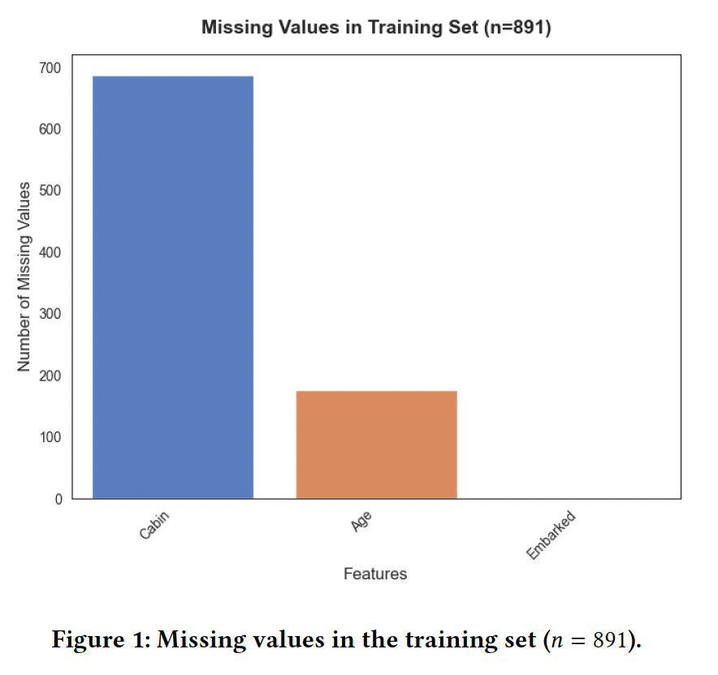
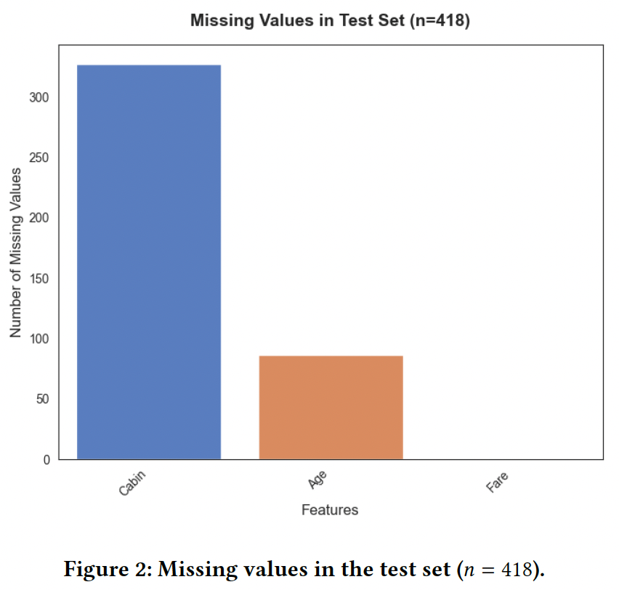
Data

Slide 6
Preprocessing
Cabin removed (majority missing)
Age and Fare imputed using the median
Embarked imputed using the mode
Duplicate rows removed
Standardized categorical attributes (Sex, Embarked, Pclass)
Consistent label encoding for train and test sets
Name preserved for later title extraction
SibSp and Parch preserved for family-based features

Slide 7
Feature Engineering
Family-based features:
FamilySize = SibSp + Parch + 1
IsAlone indicator → Strong correlation with survival likelihood
Title extraction:
Extract titles using regex (Mr, Mrs, Miss, Master, Dr...)
Merge rare titles → ’’Rare’’
Normalize female title (Mlle, Ms, Mme)
Discretization:
Age groups → Child, Teenager, Adult, Middle, Senior
Fare quartiles → lower/medium/high price ranges
All engineered categories label-encoded

Slide 8
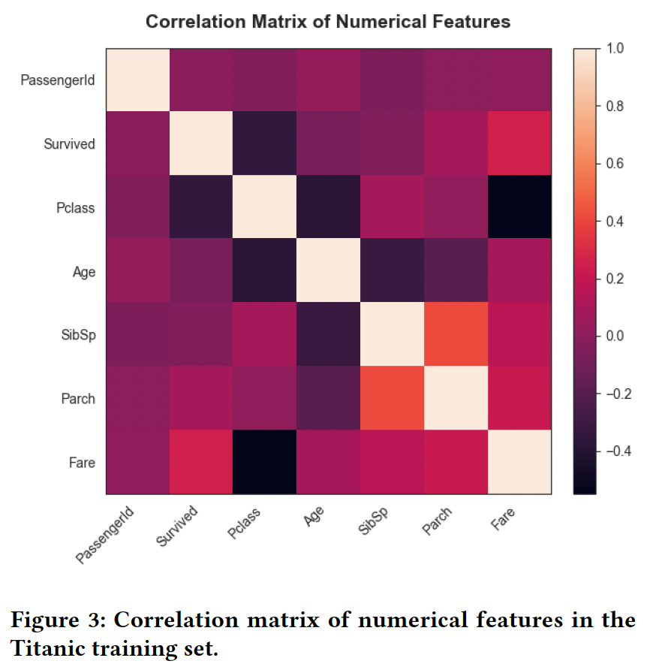
Correlation Matrix

Slide 9
Methodology
Problem formulation:
Supervies binary classification (Survived vs Not Survived)
Models used:
Support Vector Classifier (RBF kernel)
Random Forest
Evaluation setup:
80-20 stratified split
No aggressive hyperparameter tuning
Metric: accuracy
Confusion matrix used to inspect misclassification patterns

Slide 10
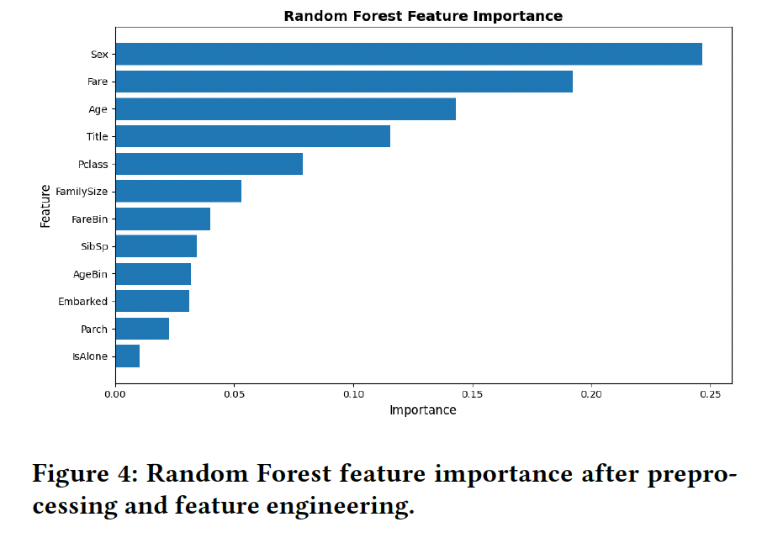
Results
Validation Accuracy:
SVC: 0.80-0.82
Random Forest: 0.83-0.86 (best)
Key Observations:
RF benefits from engineered features
Most important predictors: Sex, Fare, Age, Title, Pclass
Misclassifications concentrated among adult males
Strong performance on female and child passengers

Slide 11
Final Remarks
Both models outperform raw-attribute baselines
Systematic Preprocessing + domain-informed feature engineering are essential
The workflow emphasizes reproducibility, modularity and transparent data preparation
Random Forest is the best-performing and most stable model here

Slide 12
Thank you for your attention!
Created by:
Marczis Bálint
Bora Miklós Bence

